Slide 1
HNDIT1104: Data Representation and Organization
Negative numbers representation
Part - 1
Lesson 7

Slide 2
Learning Objectives
At the end of the lesson students should be able to
Describe importance of negative number representation
List methods of negative number representation
Convert binary number into Sign and Magnitude representation
Perform addition in between Sign and Magnitude two numbers

Slide 3
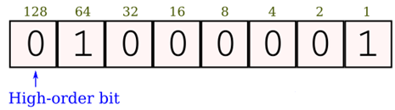
2.4 Signed Integer Representation
Negative Numbers for Computers
The conversions we have so far presented have involved only positive numbers. (Ex: 25.42)
To represent negative values (Ex: – 25.42), computer systems allocate the high-order bit to indicate the sign of a value.
The high-order bit is the leftmost bit in a byte. It is also called the most significant bit.
The remaining bits contain the value of the number.

Slide 4
2.4 Signed Integer Representation
Representation of Negative Numbers
There are three ways in which signed binary numbers may be expressed:
Signed magnitude,
One’s complement and
Two’s complement.
In an 8-bit word, signed magnitude representation places the absolute value of the number in the 7 bits to the right of the sign bit.

Slide 5
Sign-Magnitude Representation
This is one method used to represent negative numbers in Binary
Here an extra digit is placed in front the existing binary number to represent the sign
If this extra digit is a '1', it means that the rest of the digits represent a negative number
If the extra digit is a 0', it means that the number is a positive
Example : +37 = 00100101 (in 8 bits)
-37 = 10100101 (in 8 bits)
What is the range of numbers that can be represented in this method?

Slide 6
Sign-Magnitude Representation…
Example 2:
+127 = 01111111 (in 8 bits)
- 127 = 11111111 (in 8 bits)
Example 3 :
0= 00000000 (in 8 bits)
if we consider negative value of this bit stream
we get 10000000
This is also representing zero
This is a drawback of Sign-Magnitude representation
(That is two values to represent zero as +0 and -0)

Slide 7
Signed Magnitude Examples (8 bits)
-5 = 1 0000101₂ +5 = 0 0000101₂ +127 = 0 1111111₂ -127 = 1 1111111₂
For 8 bits, can represent the signed integers -127 to +127.
For N bits, can represent the signed integers
-(2^{(N-1)} - 1) to + (2^{(N-1)} - 1)

Slide 8
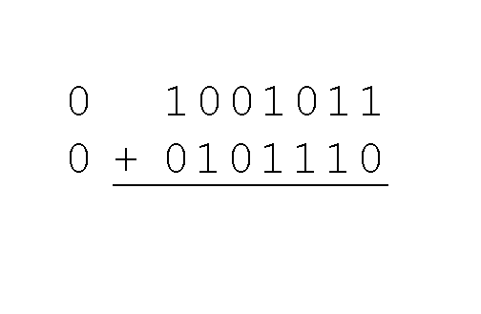
Example: Using signed magnitude binary arithmetic, find the sum of 75 and 46. r Representation
First, convert 75 and 46 to binary, and arrange as a sum, but separate the (positive) sign bits from the magnitude bits.

Slide 9
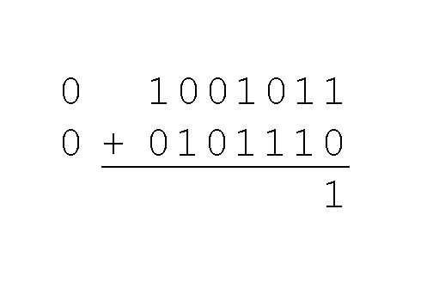
Example: Using signed magnitude binary arithmetic, find the sum of 75 and 46. r Representation
Just as in decimal arithmetic, we find the sum starting with the rightmost bit and work left.

Slide 10
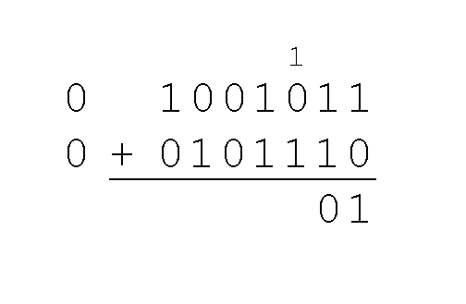
Example: Using signed magnitude binary arithmetic, find the sum of 75 and 46. r Representation
In the second bit, we have a carry, so we note it above the third bit.

Slide 11
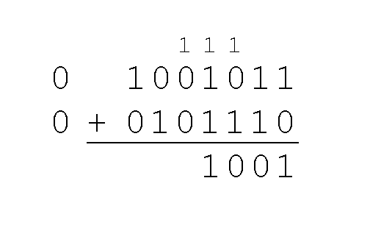
Example: Using signed magnitude binary arithmetic, find the sum of 75 and 46. r Representation
The third and fourth bits also give us carries.

Slide 12
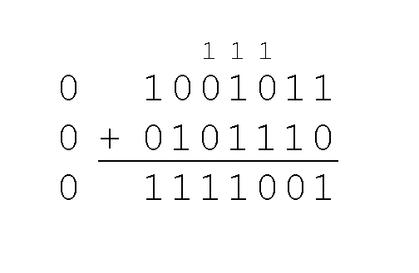
Example: Using signed magnitude binary arithmetic, find the sum of 75 and 46. r Representation
Once we have worked our way through all eight bits, we are done.
In this example, we were careful to pick two values whose sum would fit into seven bits. If that is not the case, we have a problem.

Slide 13
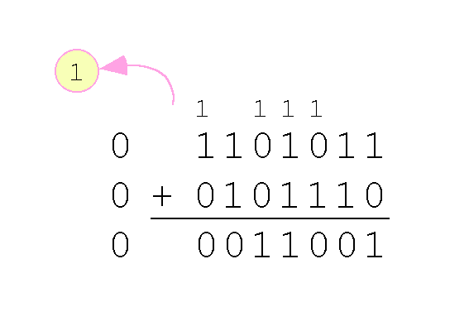
Example: Using signed magnitude binary arithmetic, find the sum of 75 and 46. r Representation
We see that the carry from the seventh bit overflows and is discarded, giving us the erroneous result: 107 + 46 = 25.

Slide 14

2.4 Signed Integer Representation
Problem with sign bit system
Signed magnitude representation is easy for people to understand, but it requires complicated computer hardware.
Another disadvantage of signed magnitude is that it allows two different representations for zero: positive zero and negative zero.
For these reasons (among others) computers systems employ complement systems for numeric value representation.

